Slide 1
TMDB 5000 Movie Dataset
How can we determine a movie's success before it is released?

Slide 2
Table of contents
01
02
03
Overview
About dataset
Exploratory data analysis
Describe the main problem
Brief about the dataset that is used
Trying to understand data and find all problems in each column
04
05
Feature engineering
Data analysis
Trying to extract new columns from existing ones
Trying to find the relationship between columns

Slide 3
01. Overview
It is important to understand what the main factors are that may affect the commercial success of movies

Slide 4
02
About Dataset

Slide 5
02. About Dataset
Our dataset consists of 2 sub-datasets (Credits, Movies)
both of them are in CSV format
those datasets will be joined (inner) by using movie_id (column in Credits dataset ) and id(column in Movies dataset)
The main dataset will contain 4803 rows and 23 columns
Each row in the main dataset represents a movie
Data source ‘Kaggle’

Slide 6
02. About Dataset
Data Frames
Credits
Movies
DF
Contains information about crew & cast for each movie
4803 rows ,
4 columns
1 numerical ,
1 object ‘str’ ,
2 objects ‘string in form list’
Contains movies’ details
4803 rows ,
20 columns
7 numerical ,
7 object ‘str’ ,
5 objects ‘string in form list’
Contains all data after joining
4803 rows ,
23 columns
7 numerical ,
8 object ‘str’ ,
7 objects ‘string in form list’

Slide 7
03
Exploratory data analysis

Slide 8
03. EDA
EDA process is applied on ( DF ) data Frame
The number of duplicated rows in DF is : 0
The number of duplicated columns in DF is : 2
The number of missing cells in DF is : 3,941

Slide 9
Column | Missing data (NaN) | Current Data type | Actual data type | Invalid data | New column name | Drop column | Outliers
Id | 0 | int64 | int64 | No |  | Yes | No
title_x | 0 | Object(str) | Object(str) | No | title | No | No
cast | 0 | Object(str) | Object(list) | Yes [] List of dirs |  | Yes After Feature Engineering | No
crew | 0 | Object(str) | Object(list) | Yes [] List of dir |  | Yes After Feature Engineering | No
budget | 0 | int64 | int64 | Yes Zero million |  | No | No

Slide 10
Column | Missing data (NaN) | Current Data type | Actual data type | Invalid data | New column name | Drop column | Outliers
homepage | 3091 | Object(str) | Object(str) | No |  | Yes Missing data more than 70% | No
keywords | 0 | Object(str) | Object(list) | Yes [] List of dirs |  | Yes After Feature Engineering | No
original_language | 0 | Object(str) | Categorical | No |  | No | No
original_title | 0 | Object(str) | Object(str) | No |  | Yes | No
overview | 3 | Object(str) | Object(str) | No |  | Yes After Feature Engineering | No

Slide 11
Column | Missing data (NaN) | Current Data type | Actual data type | Invalid data | New column name | Drop column | Outliers
production_companies | 0 | Object(str) | Object(list) | Yes [] List of dirs |  | Yes After Feature Engineering | No
production_countries | 0 | Object(str) | Object(list) | Yes [] List of dirs |  | Yes After Feature Engineering | No
release_date | 1 | Object(str) | datetime | No |  | Yes After Feature Engineering | No
revenue | 0 | int64 | int64 | Yes Zeros million |  | Yes After Feature Engineering | No
runtime | 2 | float64 | float64 | Yes Zeros |  | No | No

Slide 12
Column | Missing data (NaN) | Current Data type | Actual data type | Invalid data | New column name | Drop column | Outliers
Spoken_languages | 0 | Object(str) | Object(list) | Yes ????? , [] List of dirs |  | Yes After Feature Engineering | No
status | 0 | Object(str) | Object(str) | No |  | Yes After filtering data frame by ‘Released’ | No
tagline | 844 | Object(str) | Object(list) | Yes List of dictionary |  | Yes | No
title_y | 0 | Object(str) | Object(str) | No |  | Yes Includes the same data of title_x | No

Slide 13
Column | Missing data (NaN) | Current Data type | Actual data type | Invalid data | New column name | Drop column | Outliers
genres | 0 | Object(str) | Object(List) | Yes [] List of dir |  | Yes After Feature Engineering | No
popularity | 0 | float64 | float64 | No |  | No | No
vote_average | 0 | float64 | float64 | No | imdb_rate | No | No
vote_count | 2 | int64 | int64 | No | imdb_user_vote_count | No | No

Slide 14
03. EDA
Data Frame After data cleaning Process:
The Number of rows in DF is : 4,794
The number of columns in DF is : 17
(one category , one datetime , five float64 , one int64 , nine object)
The number of missing cells in DF is : 0

Slide 15
04
Feature Engineering

Slide 16
title column
04. Feature Engineering
From the title column, we have extracted the following columns:
Cloumn name | title_length
Data type | int64
Describe | The number of words in the title of each movie is shown in this column
overview column
From the overview column, we have extracted the following columns:
Cloumn name | overview_length
Data type | int64
Describe | The number of words in each movie's overview after removing stop words (in, me, myself, etc) is shown in this column.

Slide 17
runtime column
04. Feature Engineering
From the title column, we have extracted the following columns:
Cloumn name | runtime_categoty
Data type | category
Values | short , normal, semi-long , long
Describe | If runtime less than 50 min short , greater than or equal 50 and less than or equal 120 normal , greater than or equal 120 and less than or equal 180 semi-long ,otherwise long

Slide 18
keywords column
04. Feature Engineering
From the keywords column, we have extracted the following columns:
Cloumn name | Keywords_count
Data type | int64
Describe | The number of keyworks for each movie
Revenue & budget columns
From the revenue & budget columns, we have extracted the following columns:
Cloumn name | profit
Data type | float64
Describe | The difference between revenue & budget

Slide 19
Spoken_languages column
04. Feature Engineering
From the spoken_language column, we have extracted the following columns:
Cloumn name | spoken_language _count
Data type | int64
Describe | The number of spoken_language for each movie
Production_countries column
From the production_countries column, we have extracted the following columns:
Cloumn name | production_countries _count
Data type | int64
Describe | The number of production_countries for each movie

Slide 20
Production_companies column
04. Feature Engineering
From the production_companies column, we have extracted the following columns:
Cloumn name | production_companies _count
Data type | int64
Describe | The number of production_companies for each movie
genres column
From the genres column, we have extracted the following columns:
Cloumn name | genres _count
Data type | int64
Describe | The number of genres for each movie

Slide 21
release_date column
04. Feature Engineering
From the release_date column, we have extracted the following columns:
Cloumn name | release_date_year
Data type | int64
Describe | This movie has been released in which year
Cloumn name | release_date_month
Data type | object
Describe | This movie has been released in which month

Slide 22
release_date column
04. Feature Engineering
From the release_date column, we have extracted the following columns:
Cloumn name | release_date_day
Data type | object
Describe | This movie has been released in which day

Slide 23
cast column
04. Feature Engineering
From the cast column, we have extracted the following columns:
Cloumn name | cast_total_number
Data type | int64
Describe | Total number of cast member in each movie
Cloumn name | movie_age
Data type | int64
Describe | This movie has been released for how many years
crew column
From the crew column, we have extracted the following columns:
Cloumn name | crew_total_number
Data type | int64
Describe | Total number of crew member in each movie
Cloumn name | movie_age
Data type | int64
Describe | This movie has been released for how many years

Slide 24
04. Feature Engineering
Data Frame After feature engineering Process:
The Number of rows in DF is : 3,865 ( I filtered DF by (profit > 0) )
The number of dropped columns is : 6
The number of new columns : 14
The number of columns in DF is : 25
The number of missing cells in DF is : 0

Slide 25
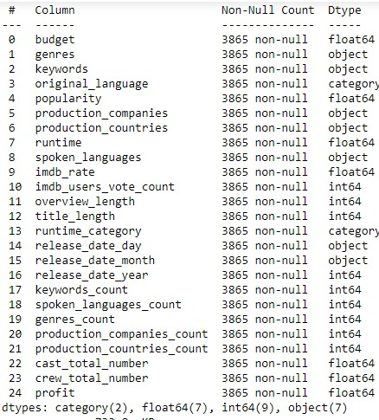

Slide 26
05
Data Analysis

Slide 27

A picture is worth a thousand words

Slide 28
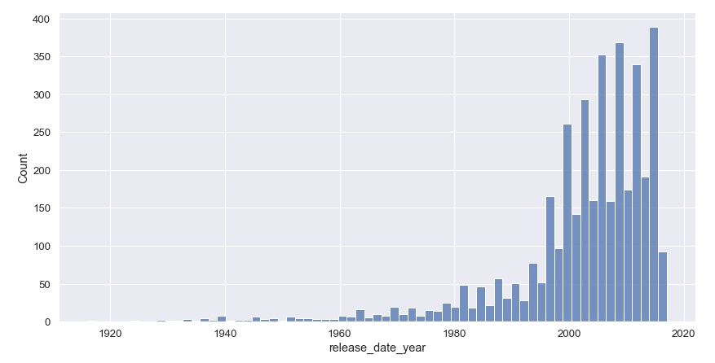
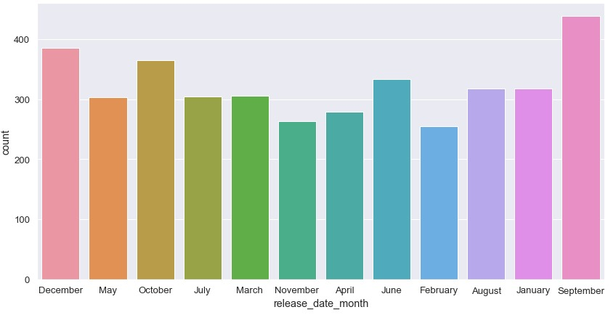
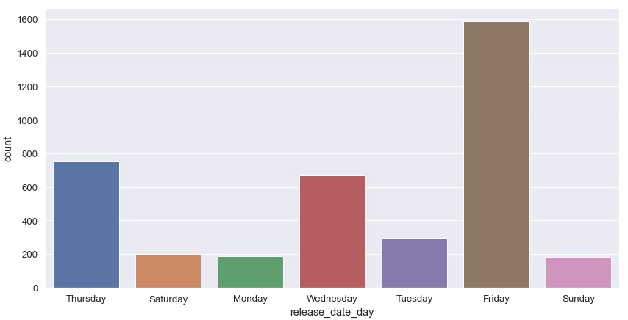
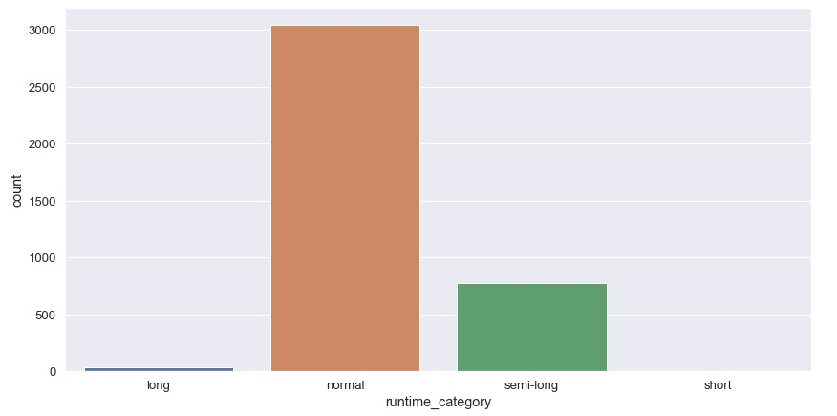
Overview
05. Data analysis

Slide 29
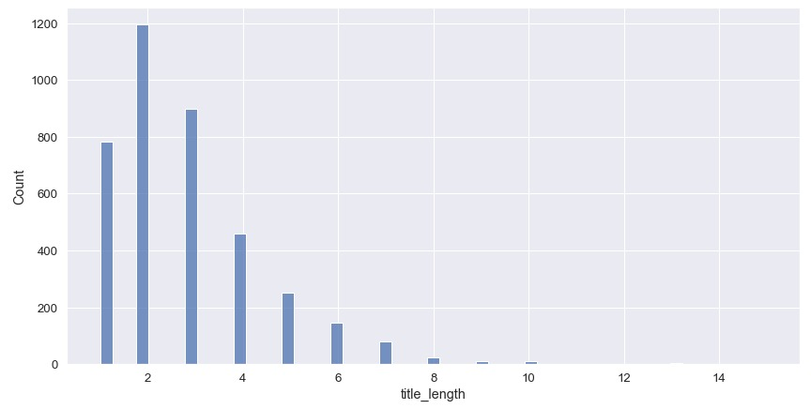
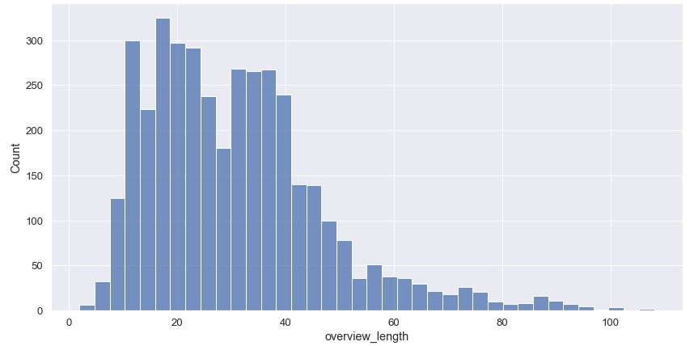
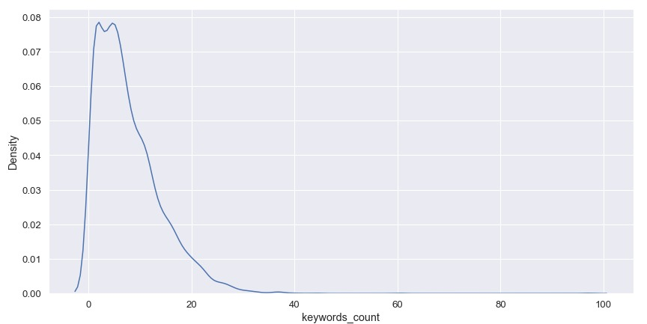
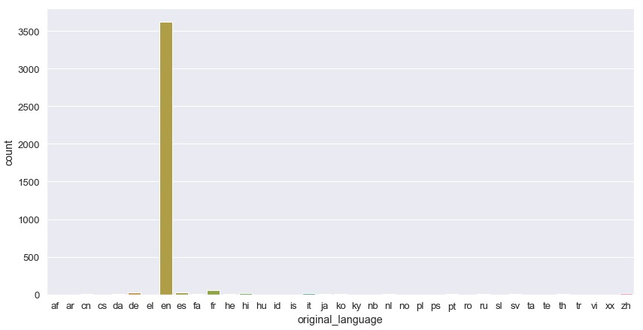
Overview
05. Data analysis

Slide 30

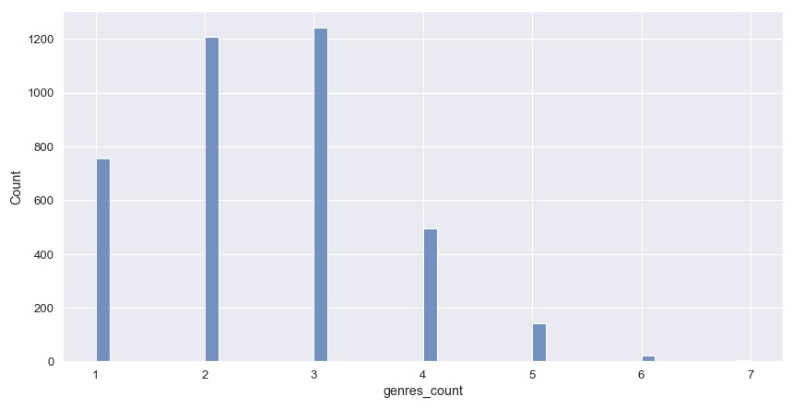
Overview
05. Data analysis

Slide 31

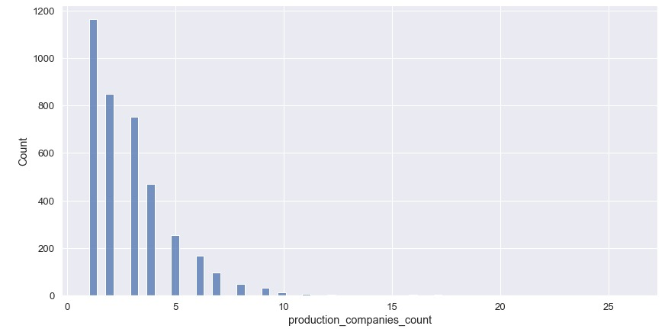
Overview
05. Data analysis

Slide 32
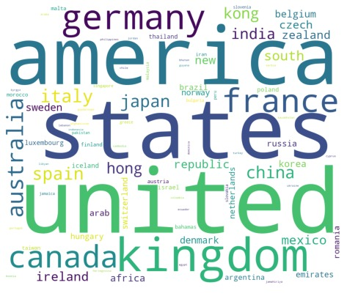
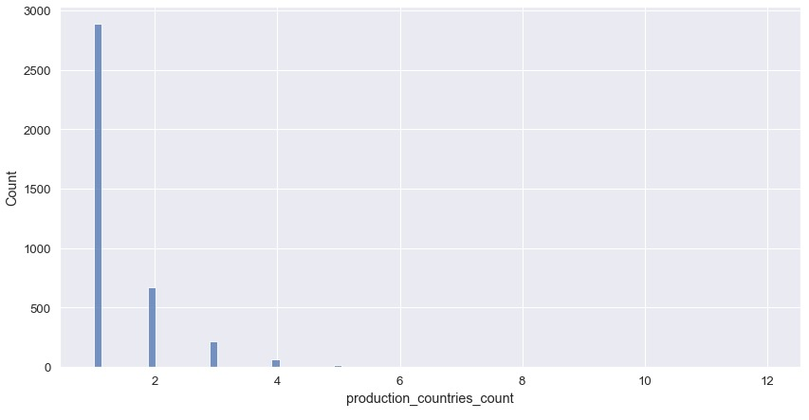
Overview
05. Data analysis

Slide 33
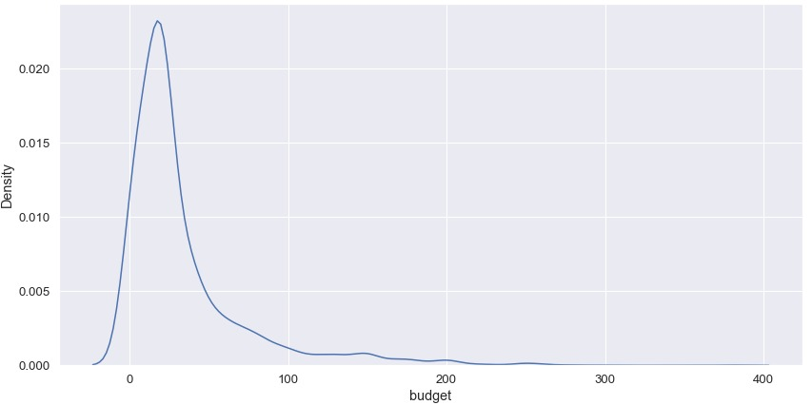
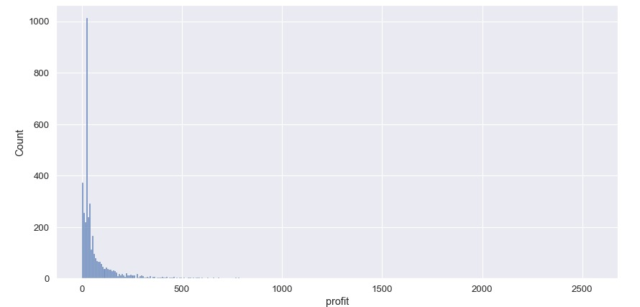
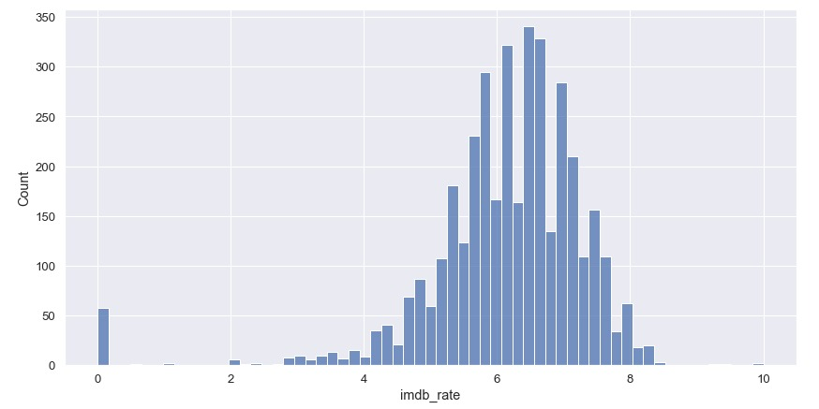
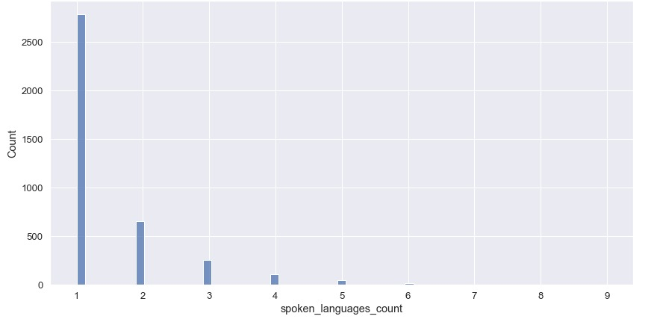
Overview
05. Data analysis

Slide 34
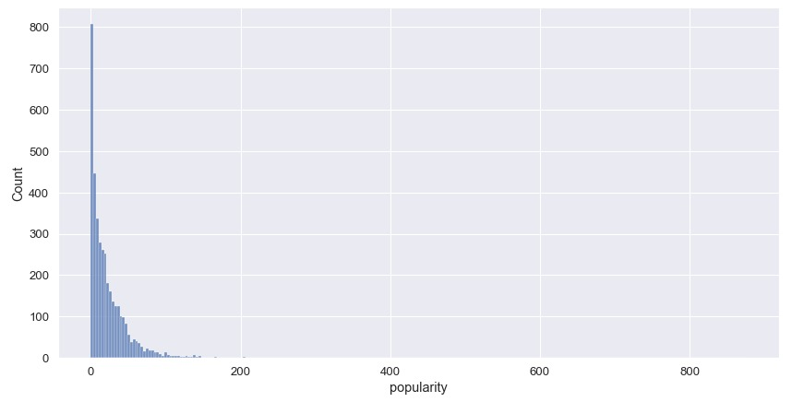
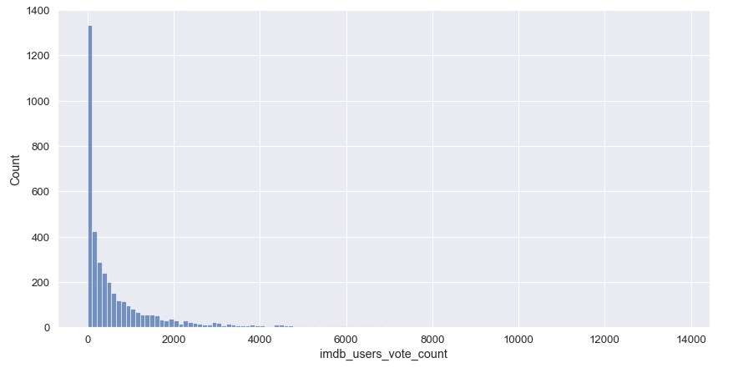
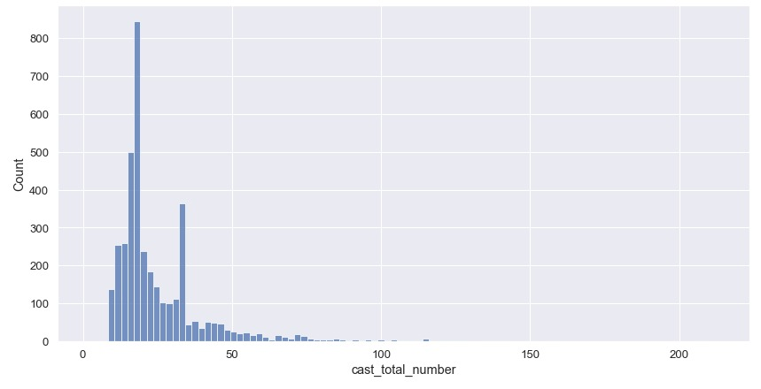
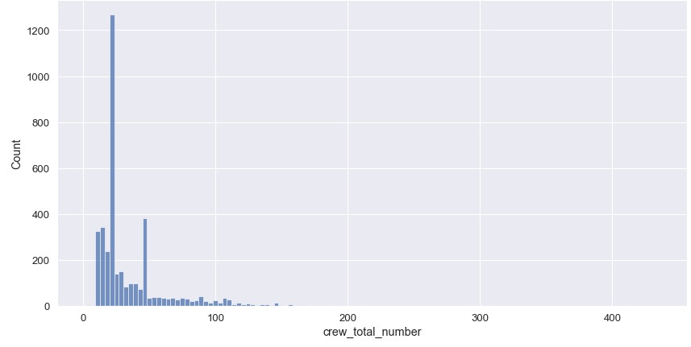
Overview
05. Data analysis

Slide 35
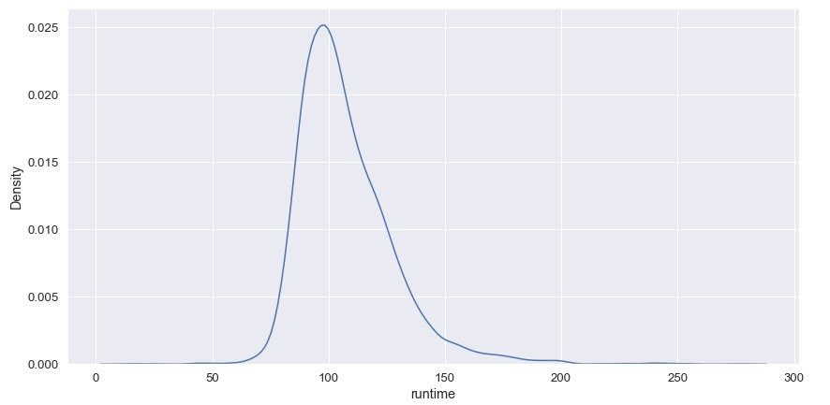
Overview
05. Data analysis

Slide 36
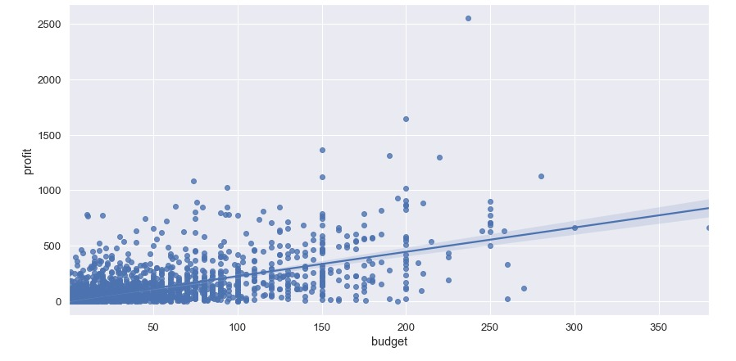
When the budget increases, does the profit increase?
05. Data analysis

Slide 37
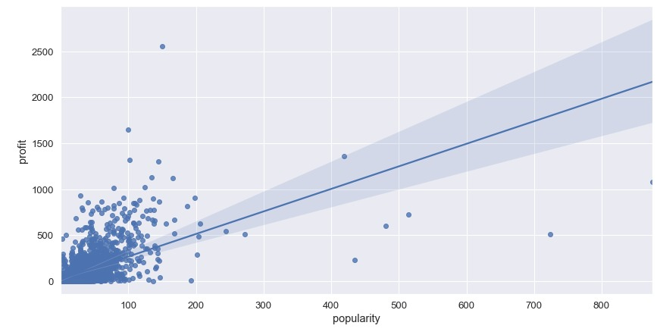
When the popularity increases, does the profit increase?
05. Data analysis

Slide 38
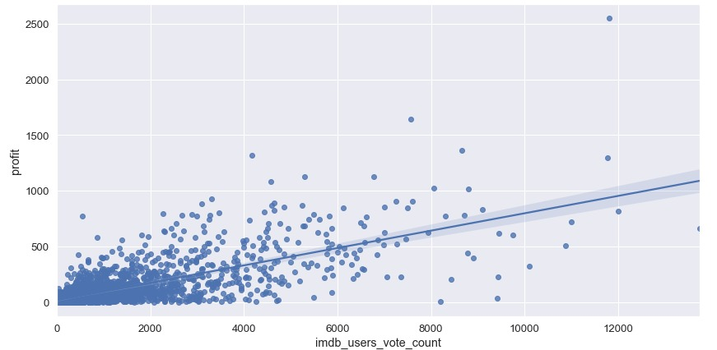
When the imdb_users_vote_count increases, does the profit increase?
05. Data analysis

Slide 39
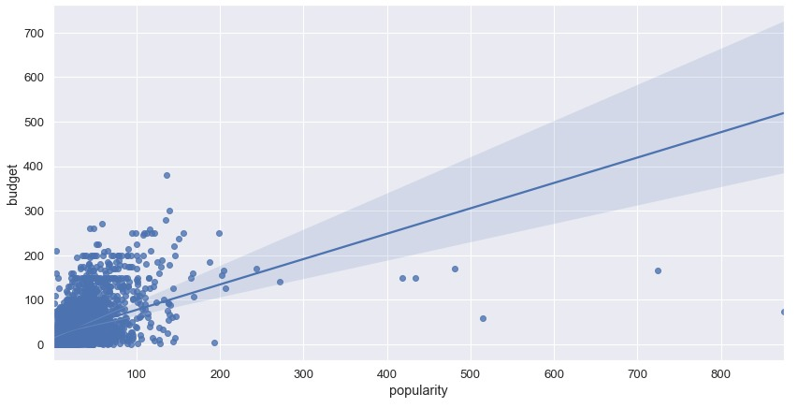
When the budget increases, does the popularity increase?
05. Data analysis

Slide 40
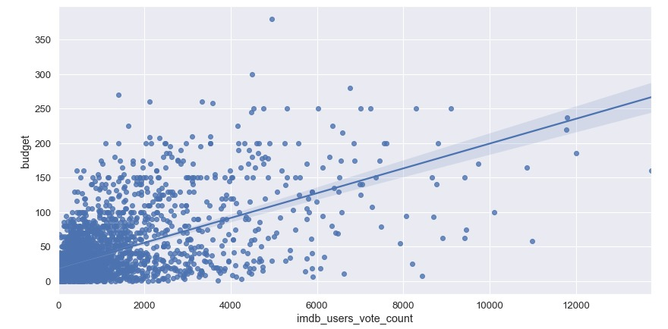
When the budget increases, does the imdb_users_vote_count increase?
05. Data analysis

Slide 41
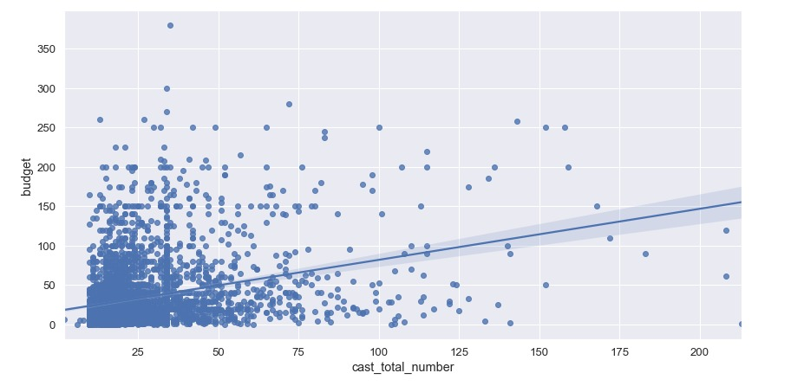
When the cast_total_number increases, does the budget increase?
05. Data analysis

Slide 42
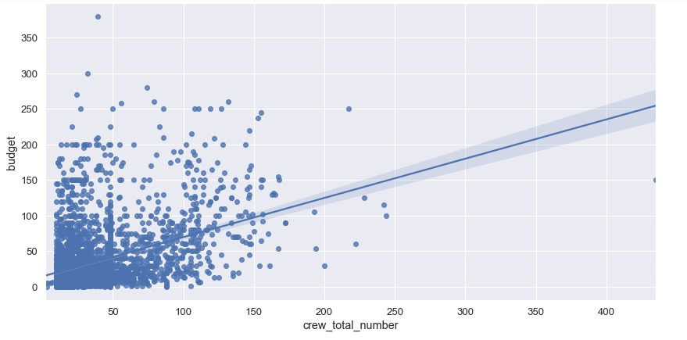
When the crew_total_number increases, does the budget increase?
05. Data analysis

Slide 43
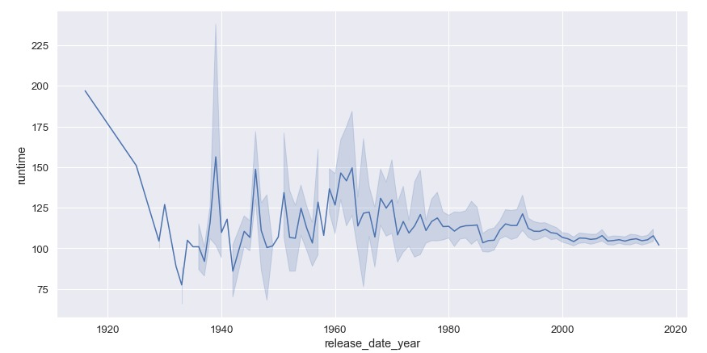
Over time , runtime increases ?
05. Data analysis

Slide 44
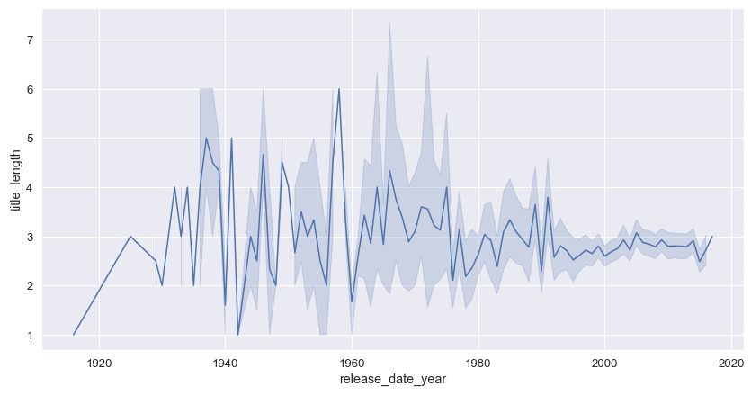
over time , title_length increases
05. Data analysis

Slide 45
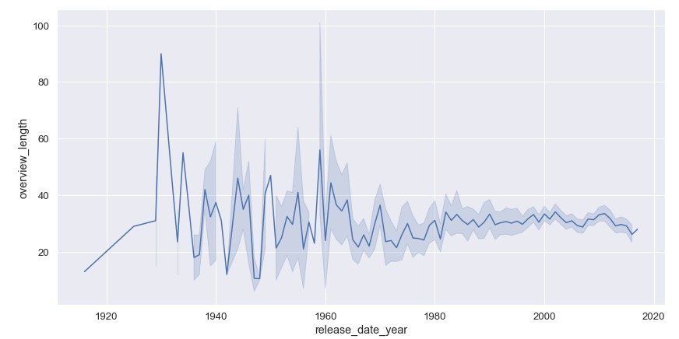
over time , overview_length increases ?
05. Data analysis

Slide 46
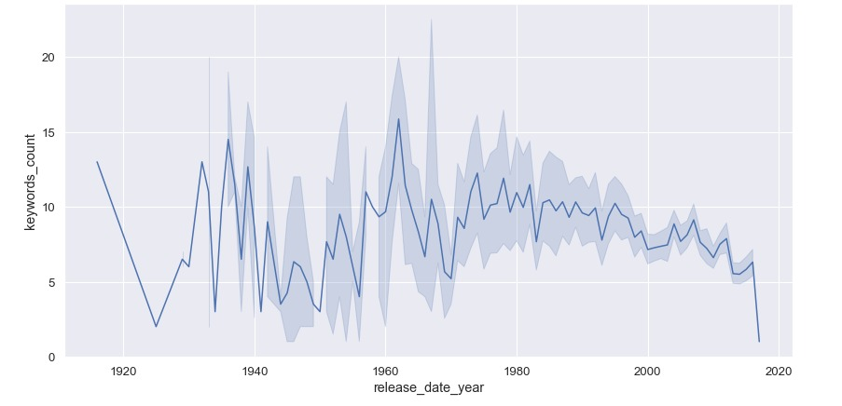
over time , keywords_count increases?
05. Data analysis

Slide 47
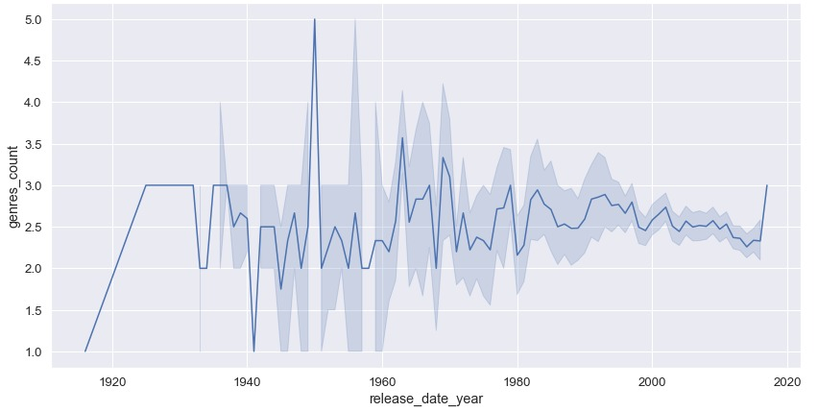
over time , genres_count increases ?
05. Data analysis

Slide 48
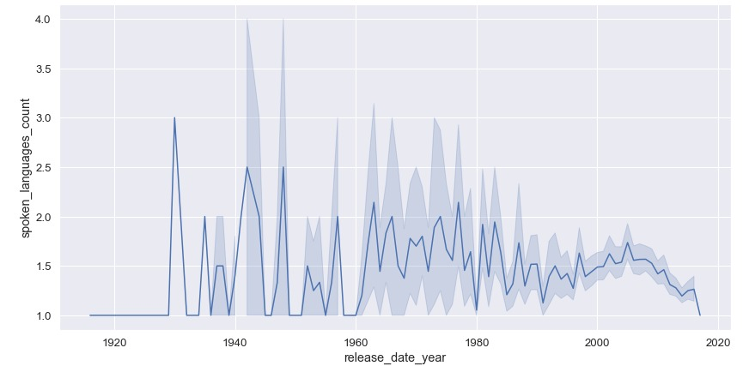
over time , spoken_languages increases ?
05. Data analysis

Slide 49
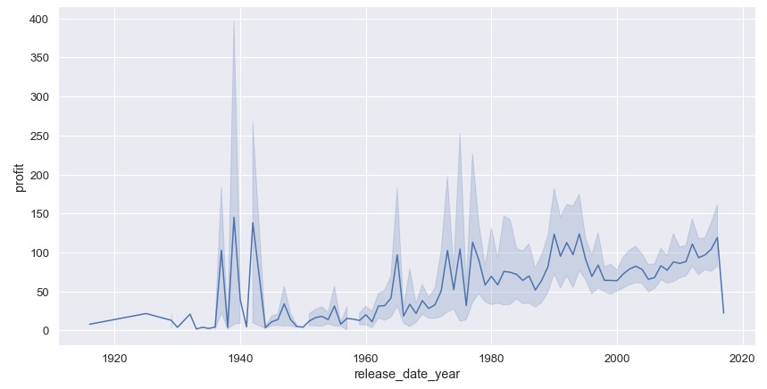
Over time , profit increases ?
05. Data analysis

Slide 50
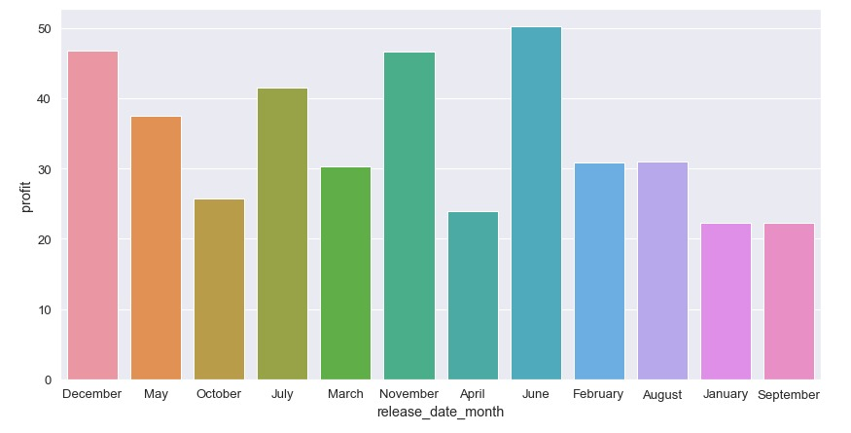
Which month has the highest profit?
05. Data analysis

Slide 51
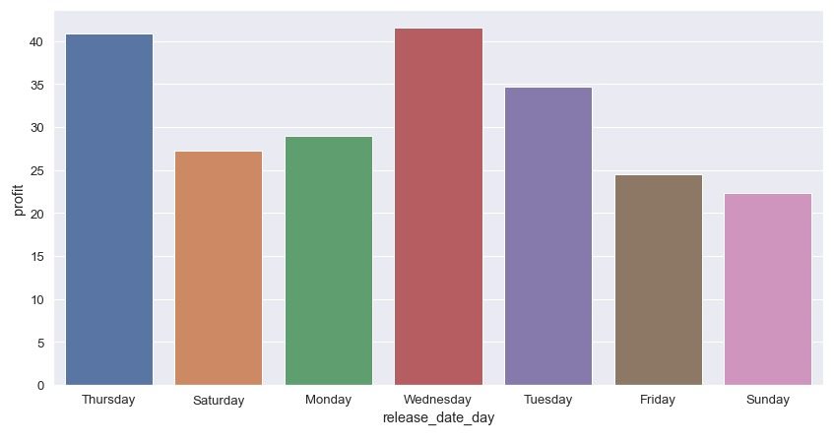
Which day has the highest profit?
05. Data analysis

Slide 52
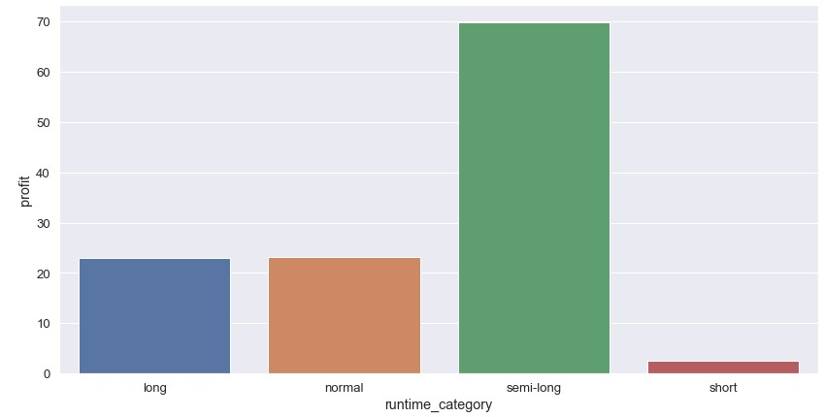
Which runtime_category has the highest profit?
05. Data analysis

Slide 53
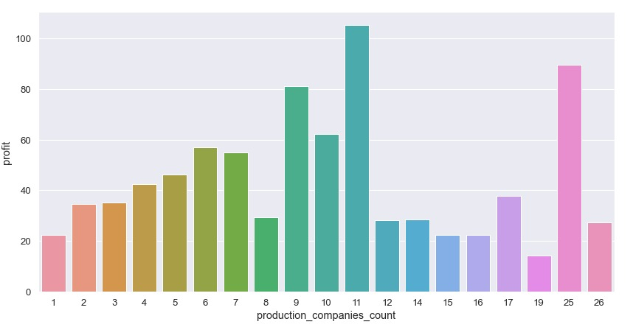
When the number of production companies increases, does the profit increase?
05. Data analysis

Slide 54
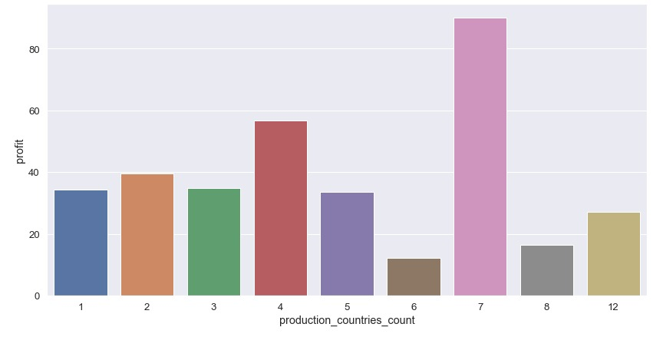
When the production_countries_count increases, does the profit increase?
05. Data analysis

Slide 55
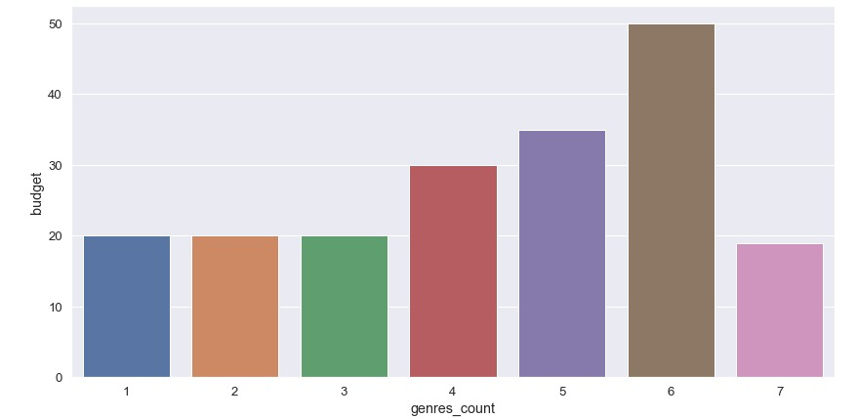
When the genres_count increases, does the budget increase?
05. Data analysis

Slide 56
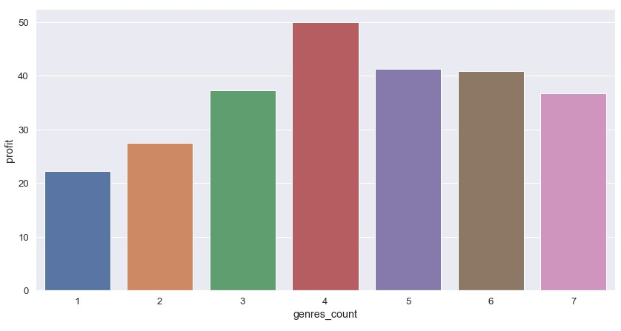
When the genres_count increases, does the profit increase?
05. Data analysis

Slide 57
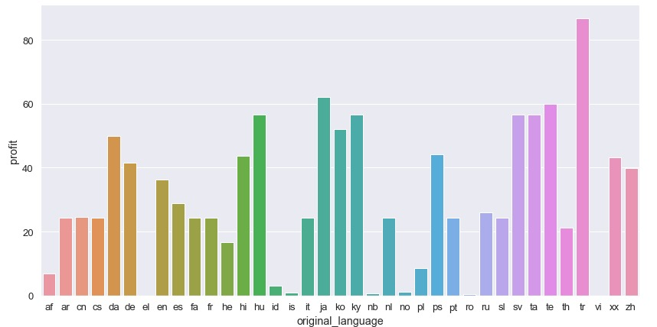
which original_language has the highest profit?
05. Data analysis

Slide 58
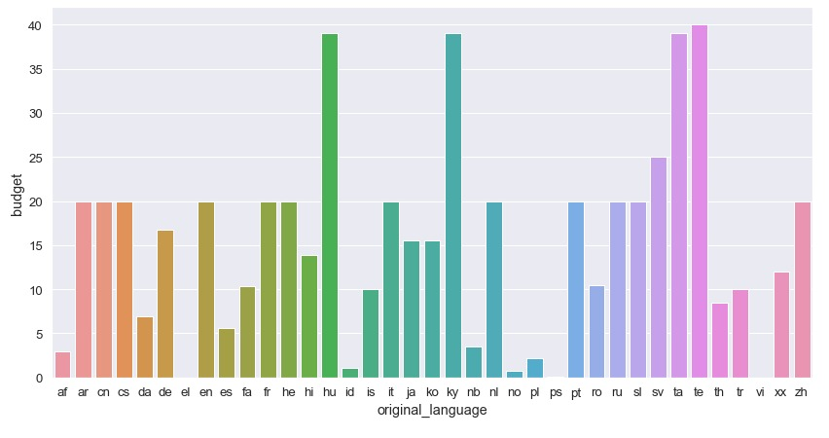
which original_language has the highest budget ?
05. Data analysis

Slide 59
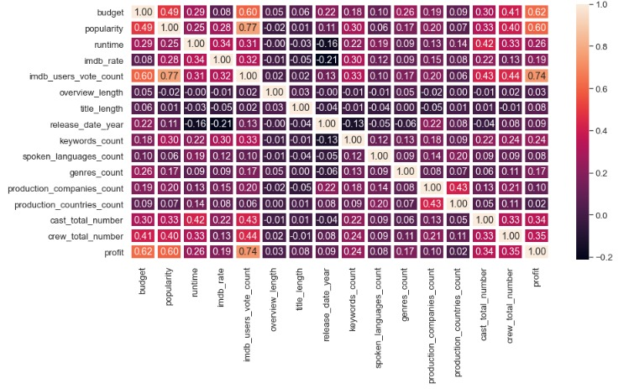
05. Data analysis

Slide 60
Recommendations
You will make more profit if you pay more in the budget
You have to care about the movie’s popularity & users vote count on IMDB
Release the movie in ‘June, December, or November’ on ‘Wednesday or Thursday’
To get high profits, make a movie in Turkish
You should aim for a runtime of between 50 and 180 minutes

Slide 61
Thanks!
Do you have any questions?
Shaimaa Moahamed

